Slide 2

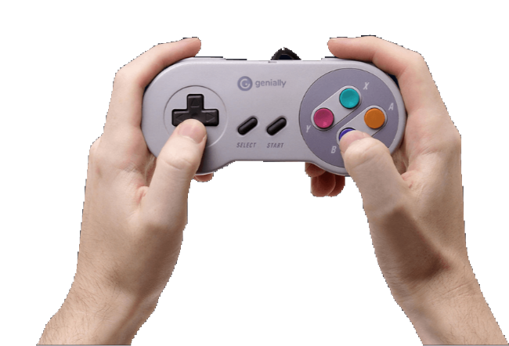
PRESENTATION
Game Controller
Game Controller
PRESS START

Slide 3

INDEX
INTRODUCTION
PROJECT OVERVIEW
COMPONENTS OF THE PROJECT
INTEGRATION
VIDEO
TEAM
THANKS

Slide 4
1
INTRODUCTION
THE IDEA OF OUR PROJECT

Slide 5


1
INTRODUCTION
blending concepts from our Computer Architecture and Computer Graphics courses

Slide 6

INTRODUCTION
Our project is a project that mixes two computer courses, one about how computers work (Computer Architecture) and another about making cool graphics (Computer Graphics).
Imagine a game that looks awesome, thanks to Computer Graphics magic with Turtle.
But here's the twist we've also created a special controller using Arduino.
It's like a remote for the game with buttons you can press.
We're excited to show you how these two things can team up to make something fun and interesting. So, let's dive in and explore the world where computers and graphics meet in our game adventure!"

Slide 7
2
PROJECT OVERVIEW
A CLOSER LOOK AT OUR PROJECT

Slide 8
2
PROJECT OVERVIEW
Our project involves developing a game using the Turtle graphics library.
This game serves as a canvas to explore the principles of Computer Graphics, while simultaneously integrating a physical controller designed with Arduino to delve into the realm of Computer Architecture."

Slide 9
3
COMPONENTS
OF THE PROJECT
THE GAME CODE AND THE HARDWARE

Slide 10

3.1
The game Code
we've implemented a captivating war game using Turtle.
The library allows us to render smooth graphics to have a good gaming experience.

Slide 11
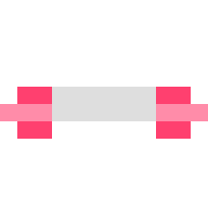
3.1
The game Code
Let’s get to Visual studio to get a better view.

Slide 12

3.2
The Arduino implementation
This physical interface consists of Keypad that serves as input device for our game.
The Arduino,acting as a microcontroller, bridges the gap between the physical world and the digital realm, demonstrating the principles of Computer Architecture in designing effective control mechanisms.

Slide 13
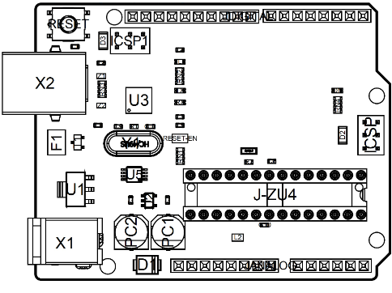
Board Topology

Slide 14
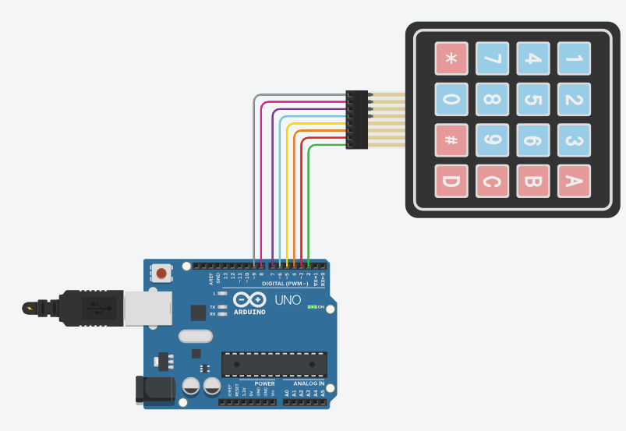
3.2
The Arduino implementation

Slide 15
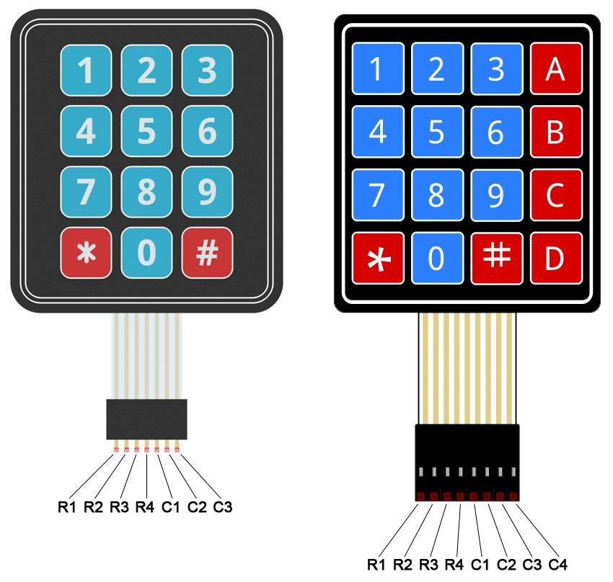

Slide 16
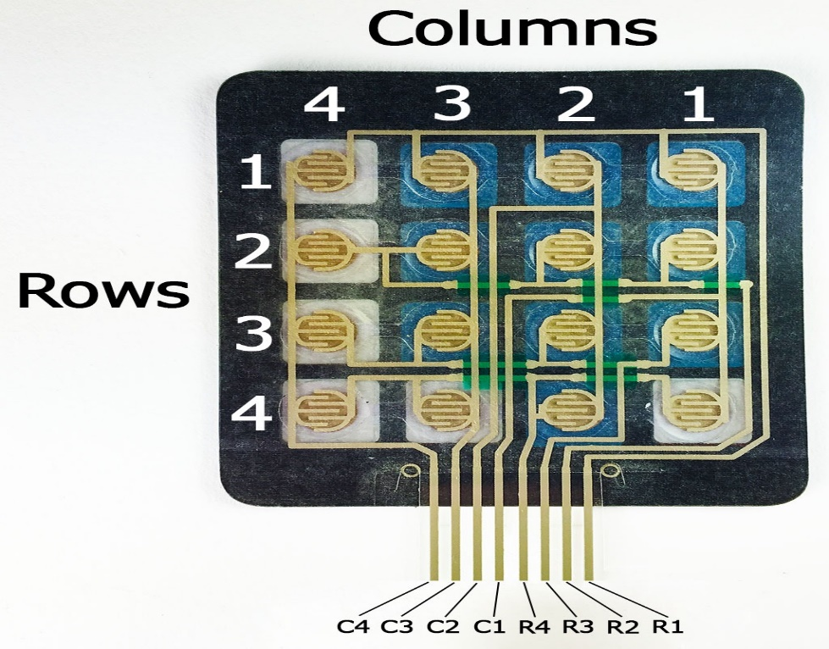

Slide 17
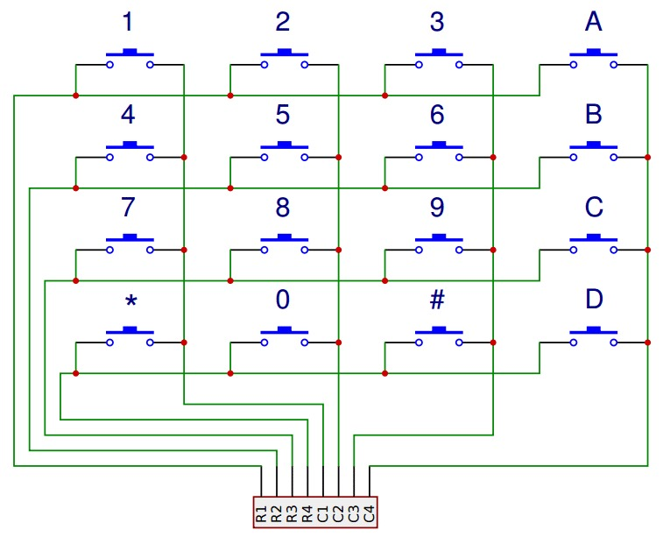

Slide 18
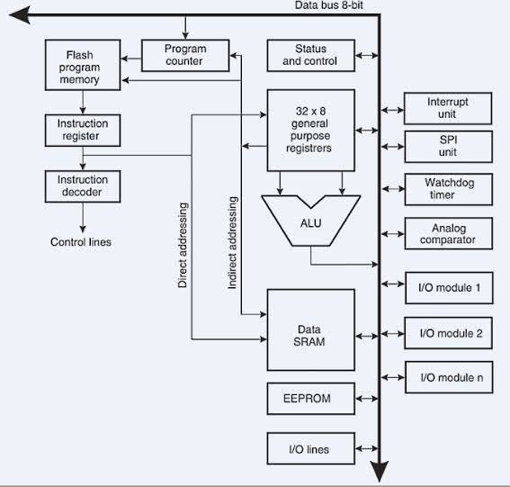

Slide 19
3.2
The Arduino implementation
Project’s code on ArduinoIDE

Slide 20
4
INTEGRATION
Mixing up all we achieved

Slide 21
4
Game Controls
Press # To move Left
Press * To move Right
Press 0 To Fire!

Slide 22
5
Video
Let's explain this in a video.

Slide 23
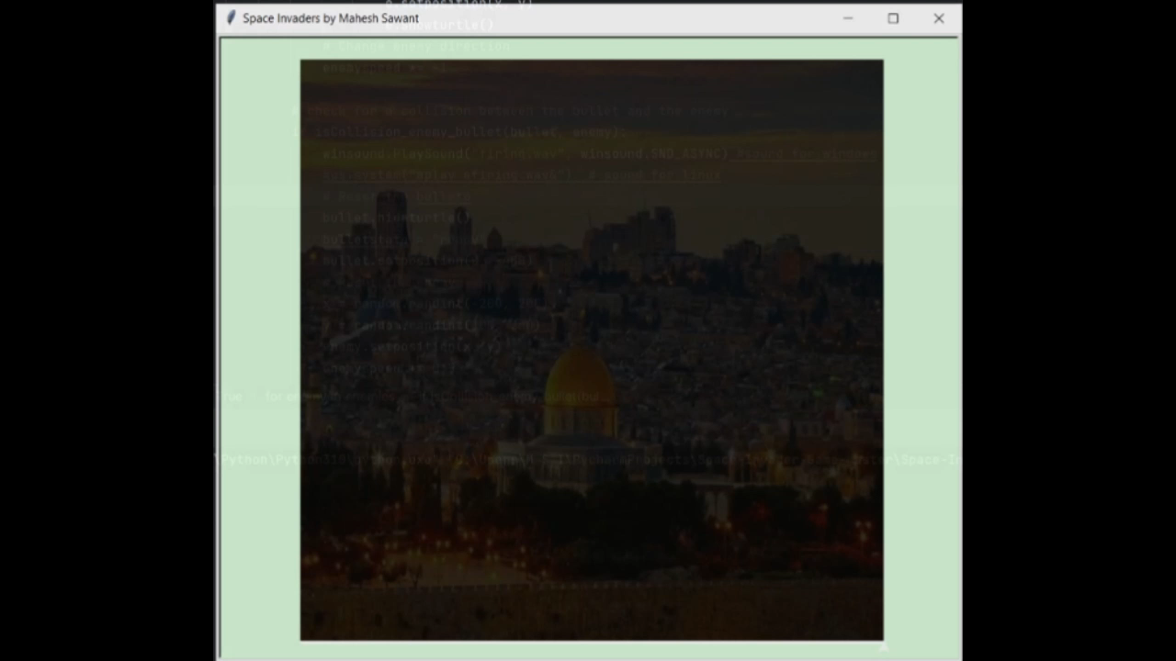
Video

Slide 24
6
TEAM
Who worked on this project?

Slide 25
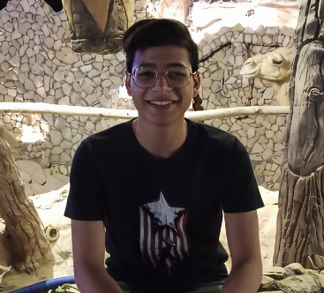



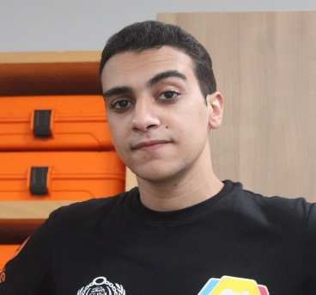
TEAM
Kareem Mohamed
Bilal Ismail
Ahemd Mohamed
Fawzy Abdelhady
Ibrahim Abdelrazek
Abdelrazek Ibrahim
Salah Saad
Salah Hafez
Asem Ibrahim
Ibrahim Gadu

Slide 26

THANKS
THANKS

